Slide 1
CIDM MT4 - System for Video Meeting Monitoring and Emotion Evaluation
Lecturer
Prof. Dalia Čalnerytė
Assoc. Prof. Andrius Kriščiūnas
UŽ KIEKVIENOS TECHNOLOGIJOS – ŽMOGUS
Group Members
Anthony Evans Weerawardene
Champika Shyamali Gunawardhana Ismala Hakuruge
Hariharan Adaikkappan
Rakhi Krishnan Radhakrishnan
Yogaselvan Saravanan
1

Slide 2
Project Overview
The system analyzes video meetings either in real time or from recorded sessions.
It detects participants' facial expressions, attention levels, and behavior cues.
Emotions such as attentive, bored, interested, neutral are classified automatically.
Engagement levels are tracked over time and combined into an engagement map.
The map highlights how the audience reacted at different points of the meeting.
The goal is to provide objective, data-driven feedback for presenters, teachers, and meeting organizers.
UŽ KIEKVIENOS TECHNOLOGIJOS – ŽMOGUS
2

Slide 3
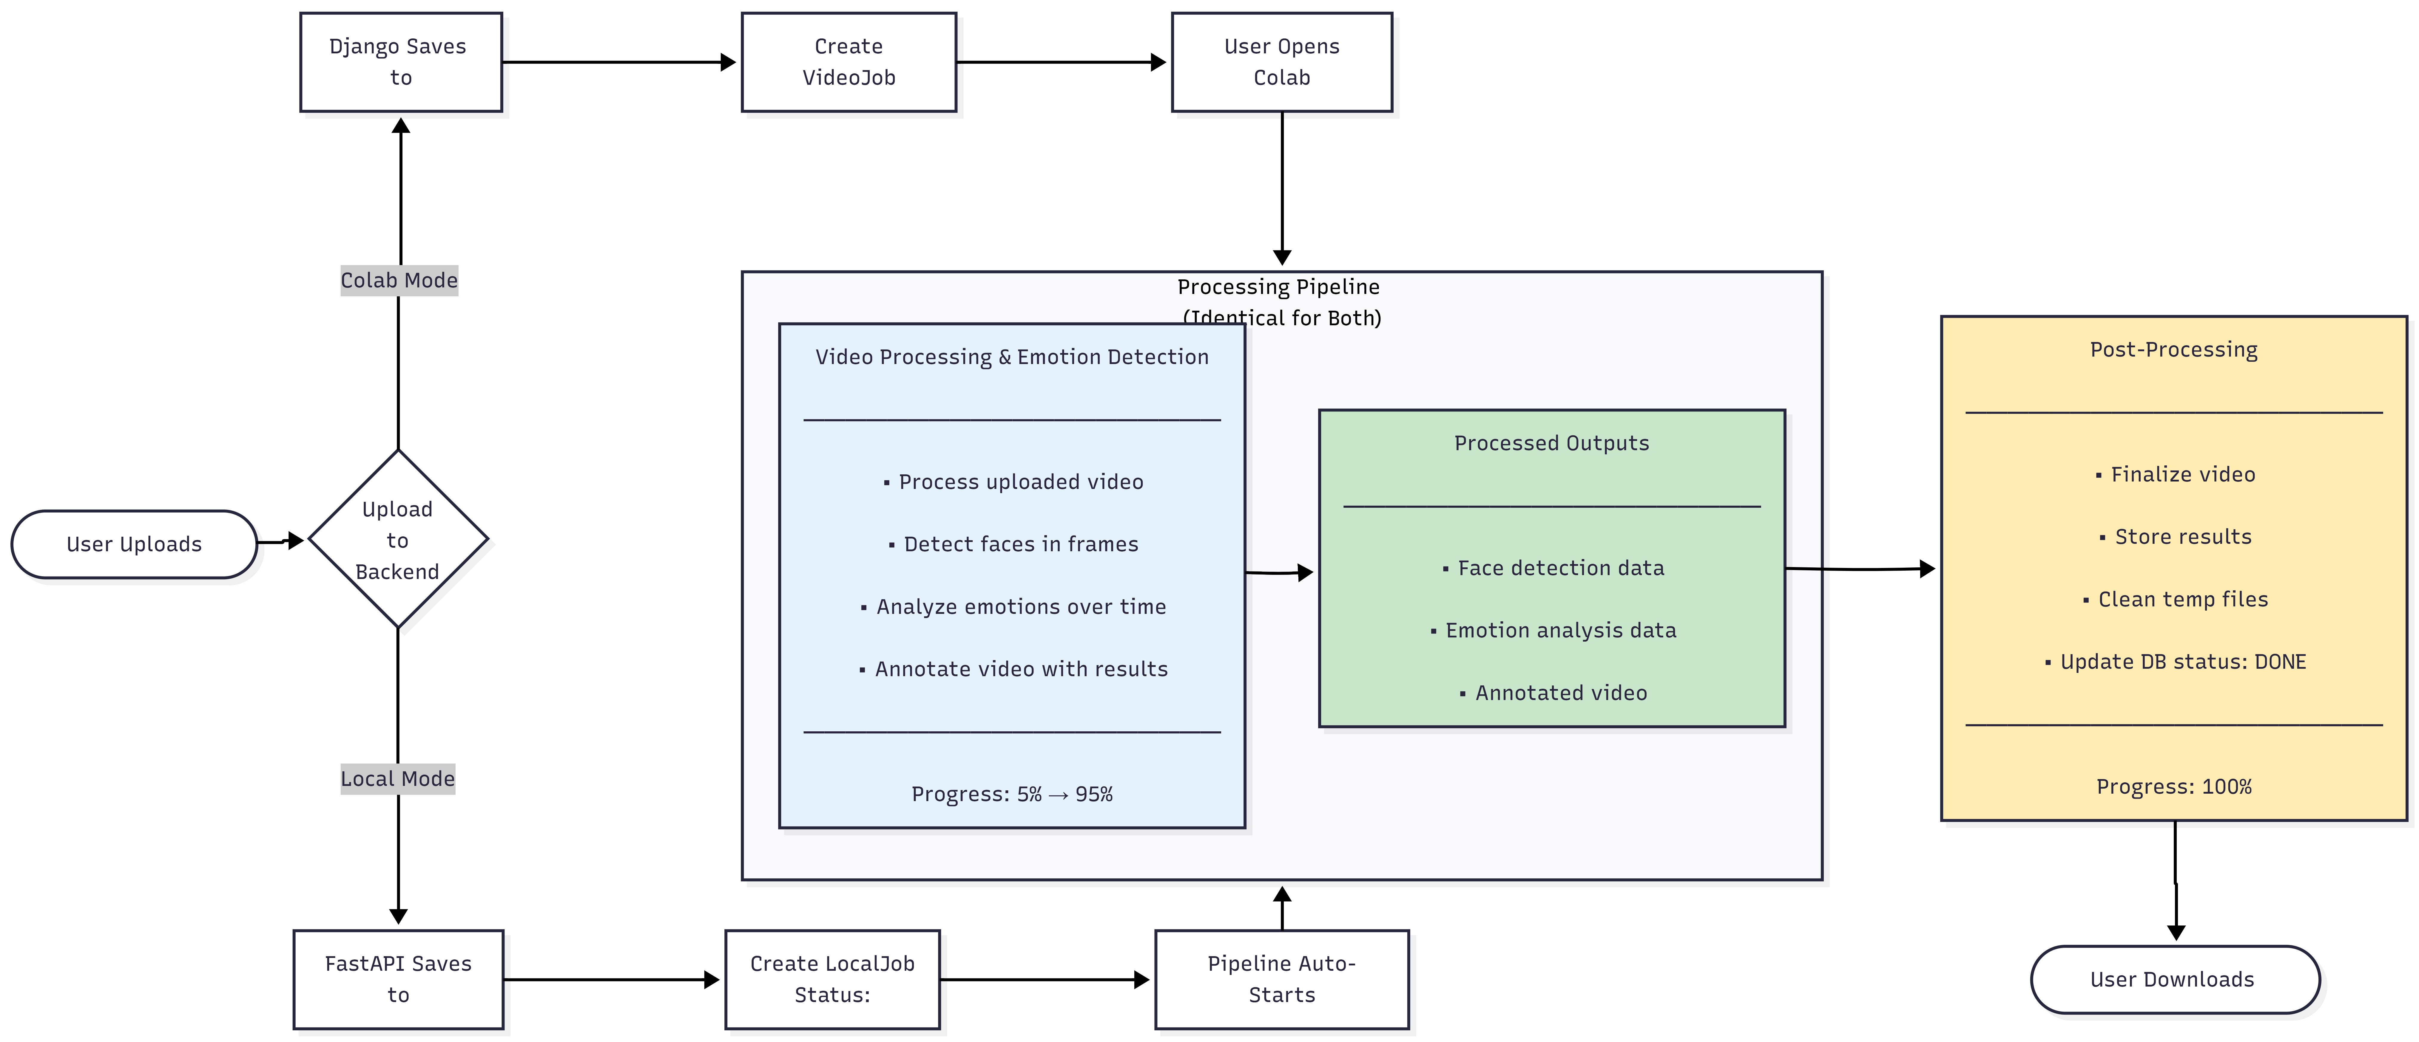
System Architecture
UŽ KIEKVIENOS TECHNOLOGIJOS – ŽMOGUS
3

Slide 4
Implementation Approach
There are 2 main approaches has been implemented
Offline Emotion detection
Select processing method (Local - deployed server or Colab)
Select a video to process
Process the video and show the processed video along with graphs of emotions detected.
Online(real time) Emotion detection
A Chrome extension is implemented
Can share the browser tab related to meeting
Extension sends server frame for every 10 and process real time
csv based on the emotion detected can be downloaded.
UŽ KIEKVIENOS TECHNOLOGIJOS – ŽMOGUS
4

Slide 5
Face Detection & Tracking
OpenCV handles frame-by-frame video processing
VideoCapture reads input, VideoWriter saves output
Face regions cropped and bounding boxes drawn
InsightFace FaceAnalysis used for face detection
Buffollo_s model is used to recognize faces
512-D facial embeddings extracted per face
Embeddings support identity tracking across frames
UŽ KIEKVIENOS TECHNOLOGIJOS – ŽMOGUS
5

Slide 6
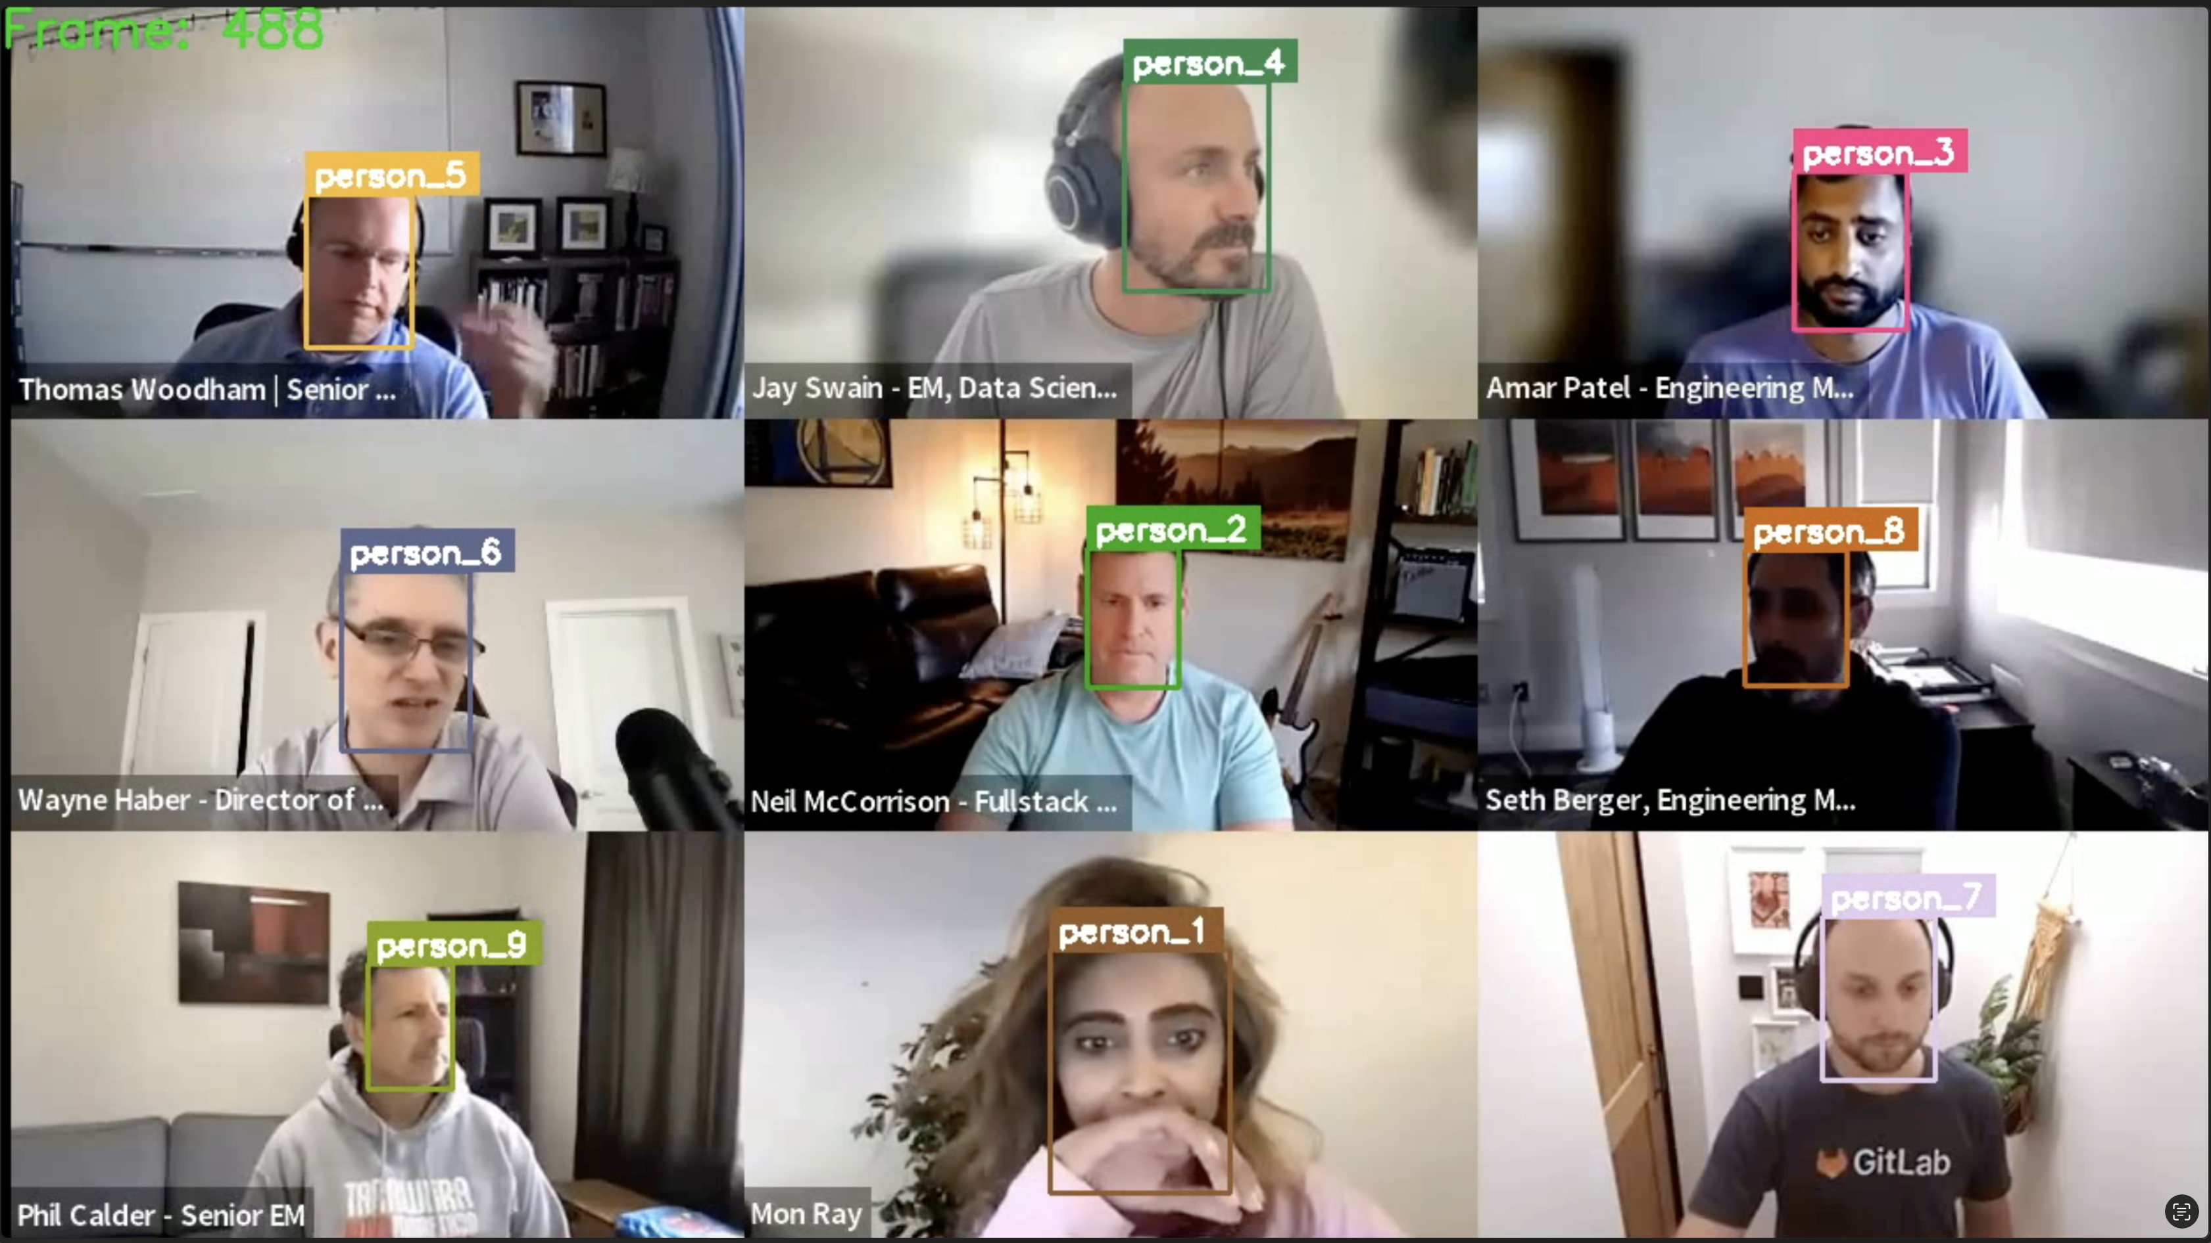
Outputs (Face Recognitions)
Each person is detected and assigned a unique ID.
The same ID is maintained across consecutive frames.
This enables continuous tracking of individuals over time.
Tracking remains stable despite movement or facial expression changes.
UŽ KIEKVIENOS TECHNOLOGIJOS – ŽMOGUS
6

Slide 7
Emotion Recognition & Acceleration
DeepFace used only for emotion classification
Predicts dominant emotion per detected face
Provides confidence scores for all emotions
Emotion analysis done on cropped face images
ONNX Runtime enables CUDA GPU acceleration
Speeds up InsightFace model inference
UŽ KIEKVIENOS TECHNOLOGIJOS – ŽMOGUS
7

Slide 8

Emotion Color Palette
UŽ KIEKVIENOS TECHNOLOGIJOS – ŽMOGUS
Defined 7 emotions based on common human emotions
For each emotions, a color is assigned
All graphs are using this color palatte
8

Slide 9
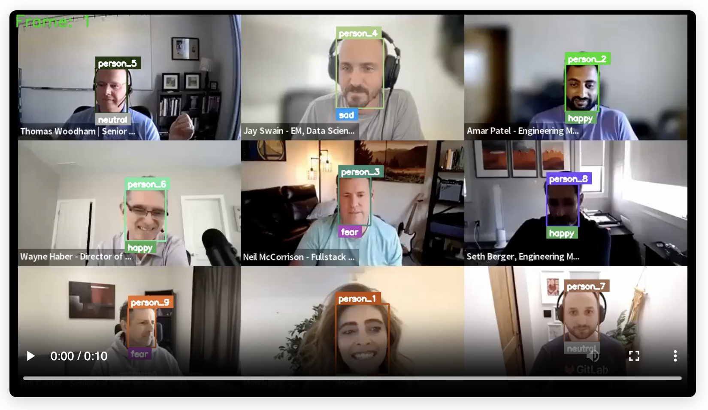
Outputs – Offline Emotion Detection (Emotion Detection)
Has to upload a video to process.
Each tracked person is analyzed for facial emotion in every frame.
The dominant emotion is displayed along with its confidence score.
Emotion labels are updated dynamically as expressions change.
UŽ KIEKVIENOS TECHNOLOGIJOS – ŽMOGUS
9

Slide 10
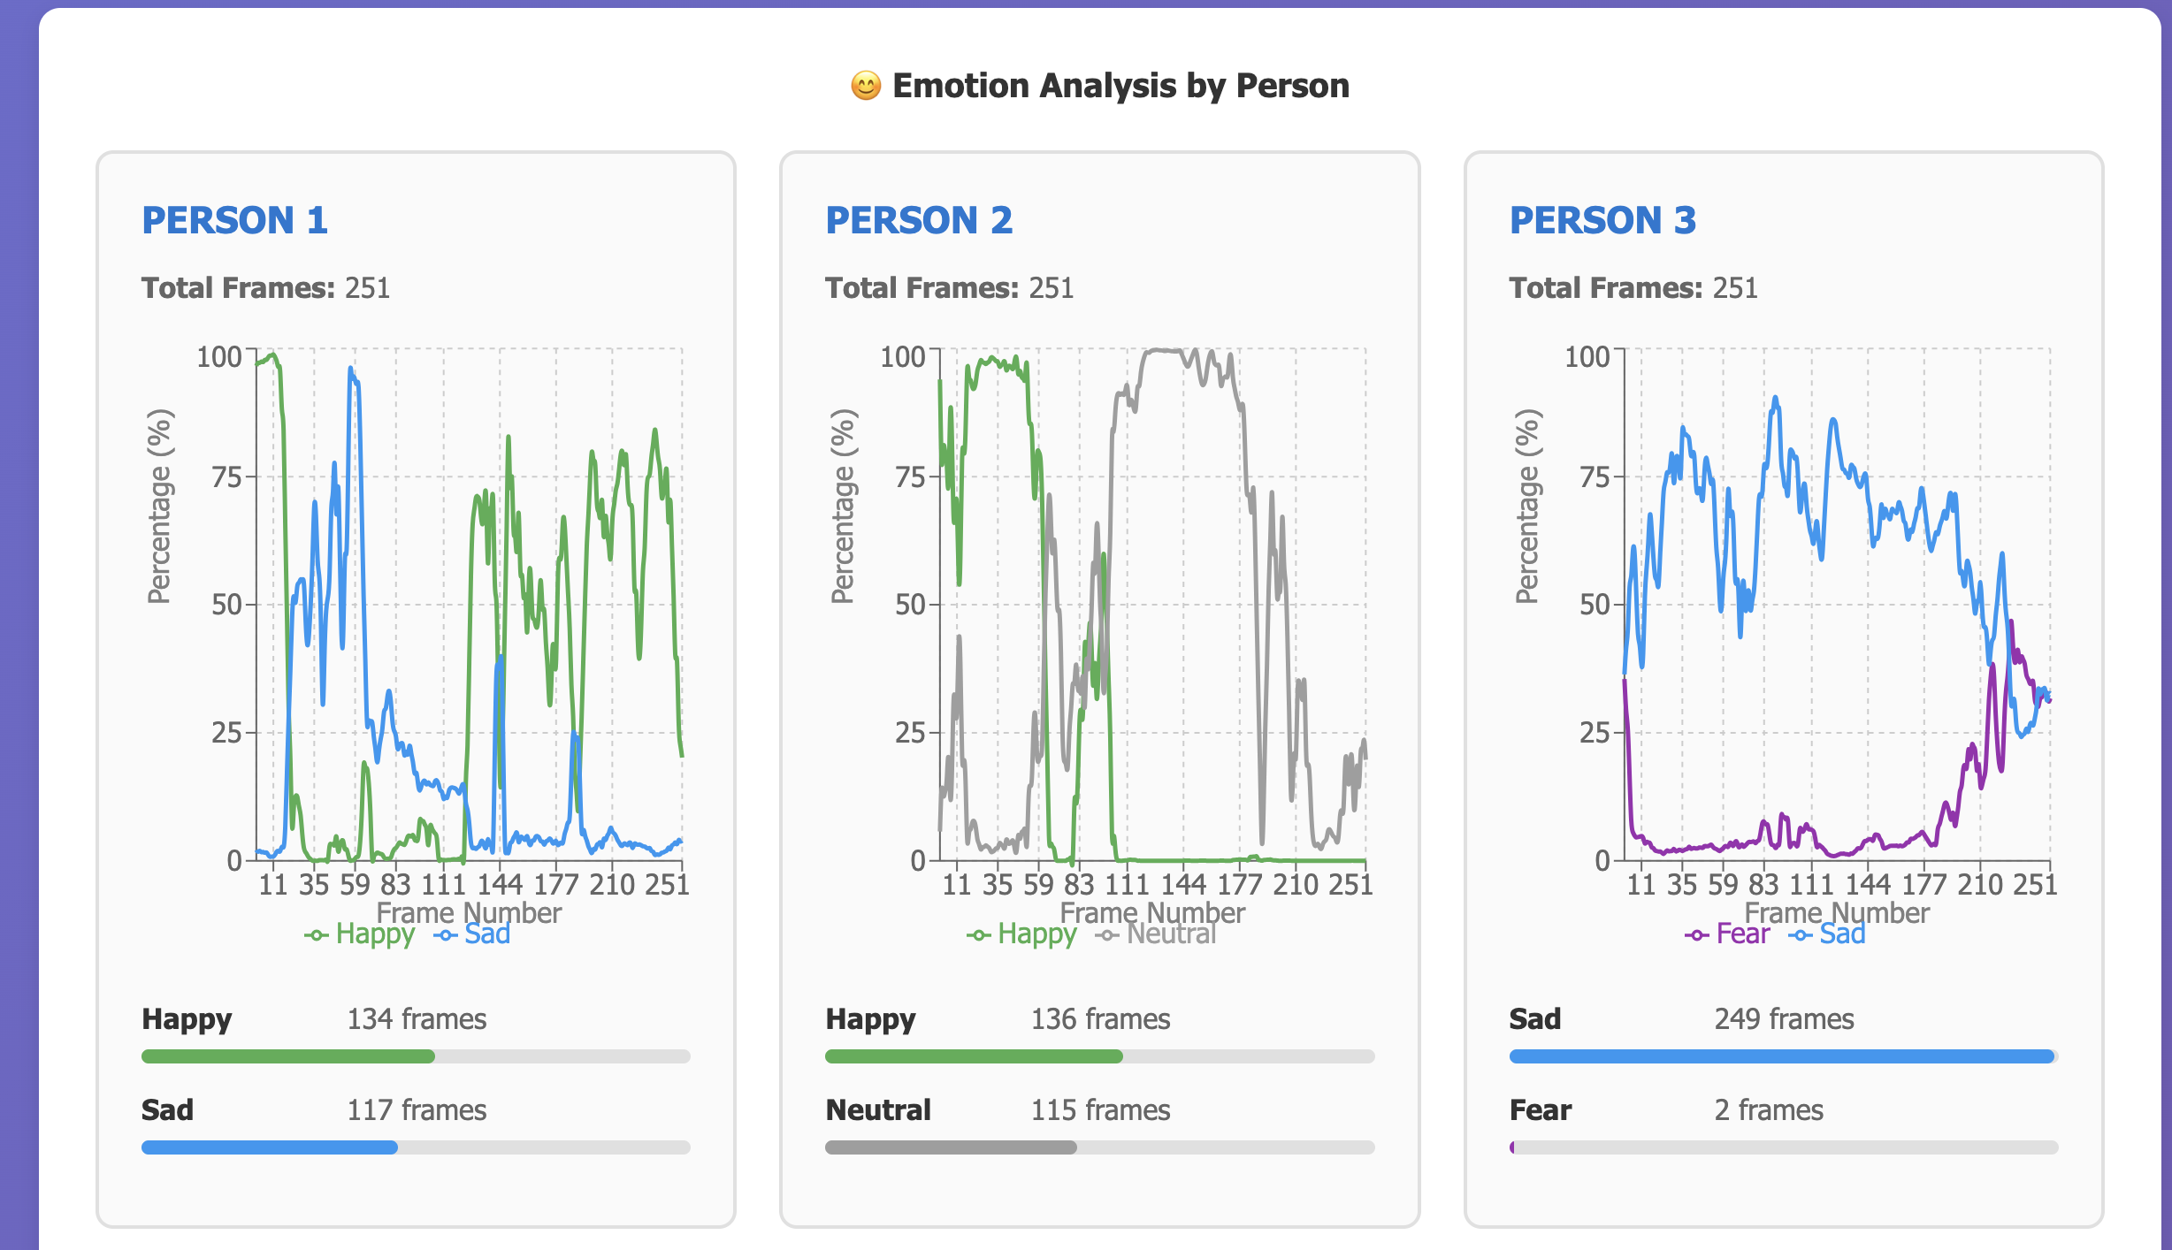
Emotion Analysis by Person
Emotion detected percentage are shown over the time.
Shows how many frames had the emotion.
For each person the graph is generated according to their emotions over the time.
The emotion type is following the defined color palette.
UŽ KIEKVIENOS TECHNOLOGIJOS – ŽMOGUS
10

Slide 11
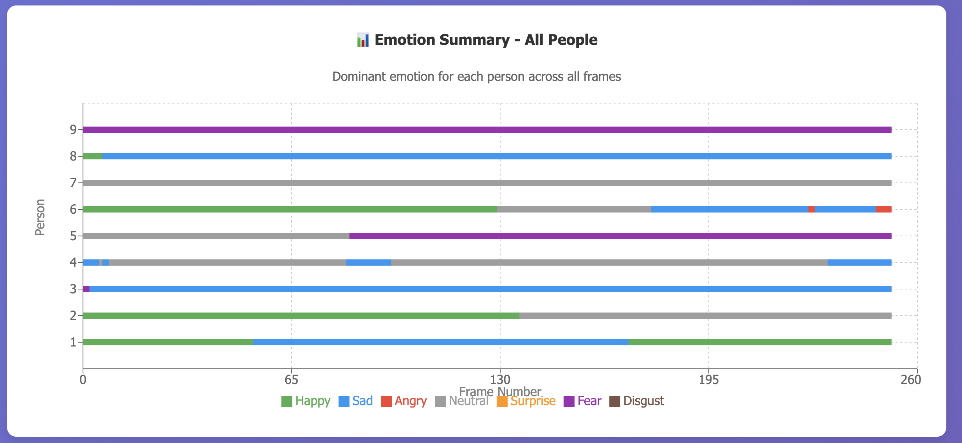
Engagement Map
Dominant emotion for each person across all frames are shown.
The emotion type is following the defined color palette.
UŽ KIEKVIENOS TECHNOLOGIJOS – ŽMOGUS
11

Slide 12
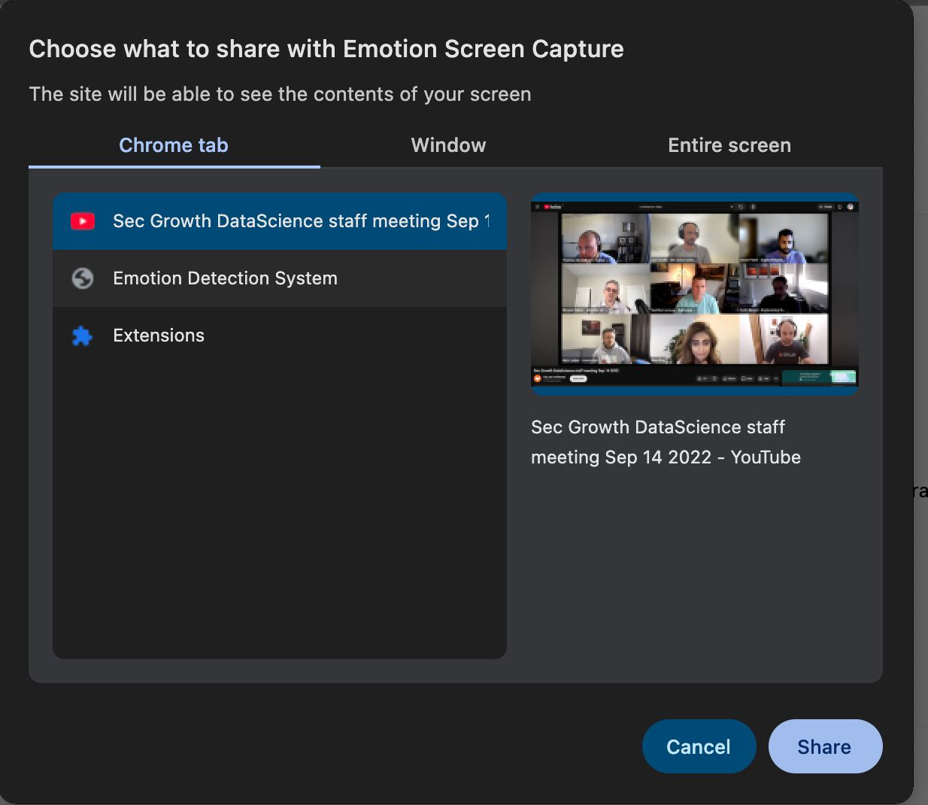
Outputs - Realtime detection (Chrome browser extension)
Currently a Chrome extension has been implemented
Click on the extension and share the related browser window.
It will automatically predict emotions.
Can generate a report based on emotions.
UŽ KIEKVIENOS TECHNOLOGIJOS – ŽMOGUS
12

Slide 13
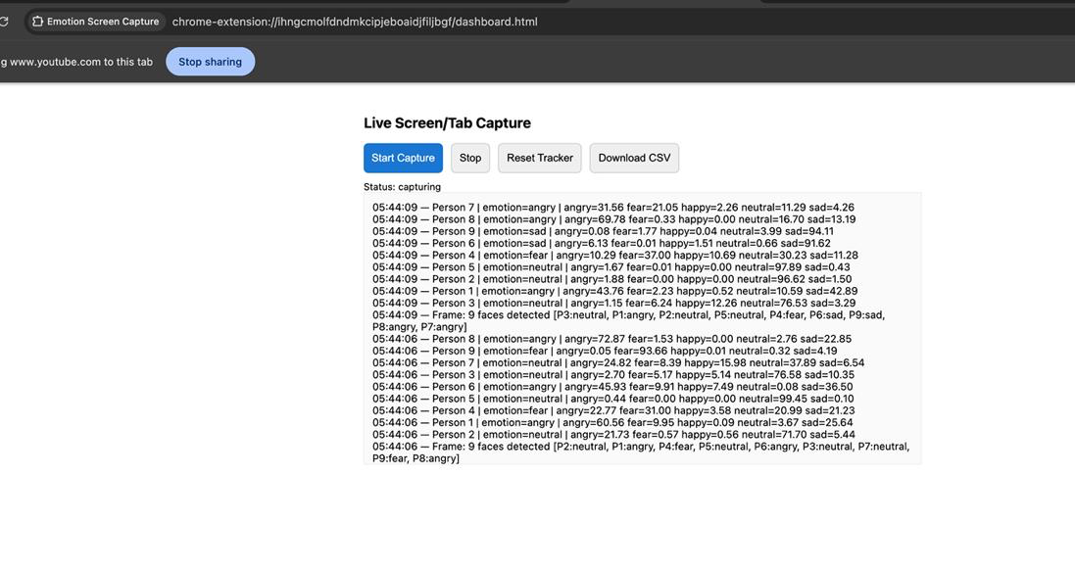
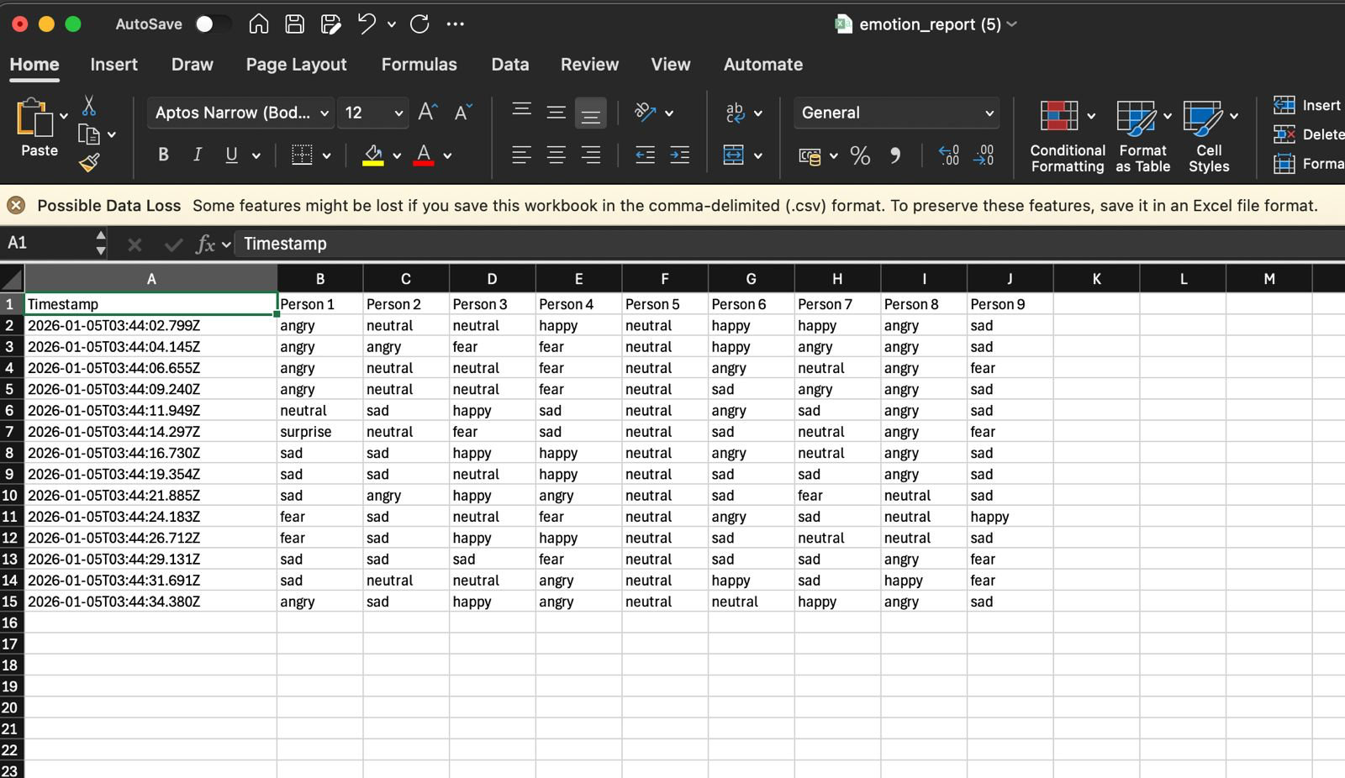
Outputs - Realtime detection (Chrome browser extension)
UŽ KIEKVIENOS TECHNOLOGIJOS – ŽMOGUS
13

Slide 14
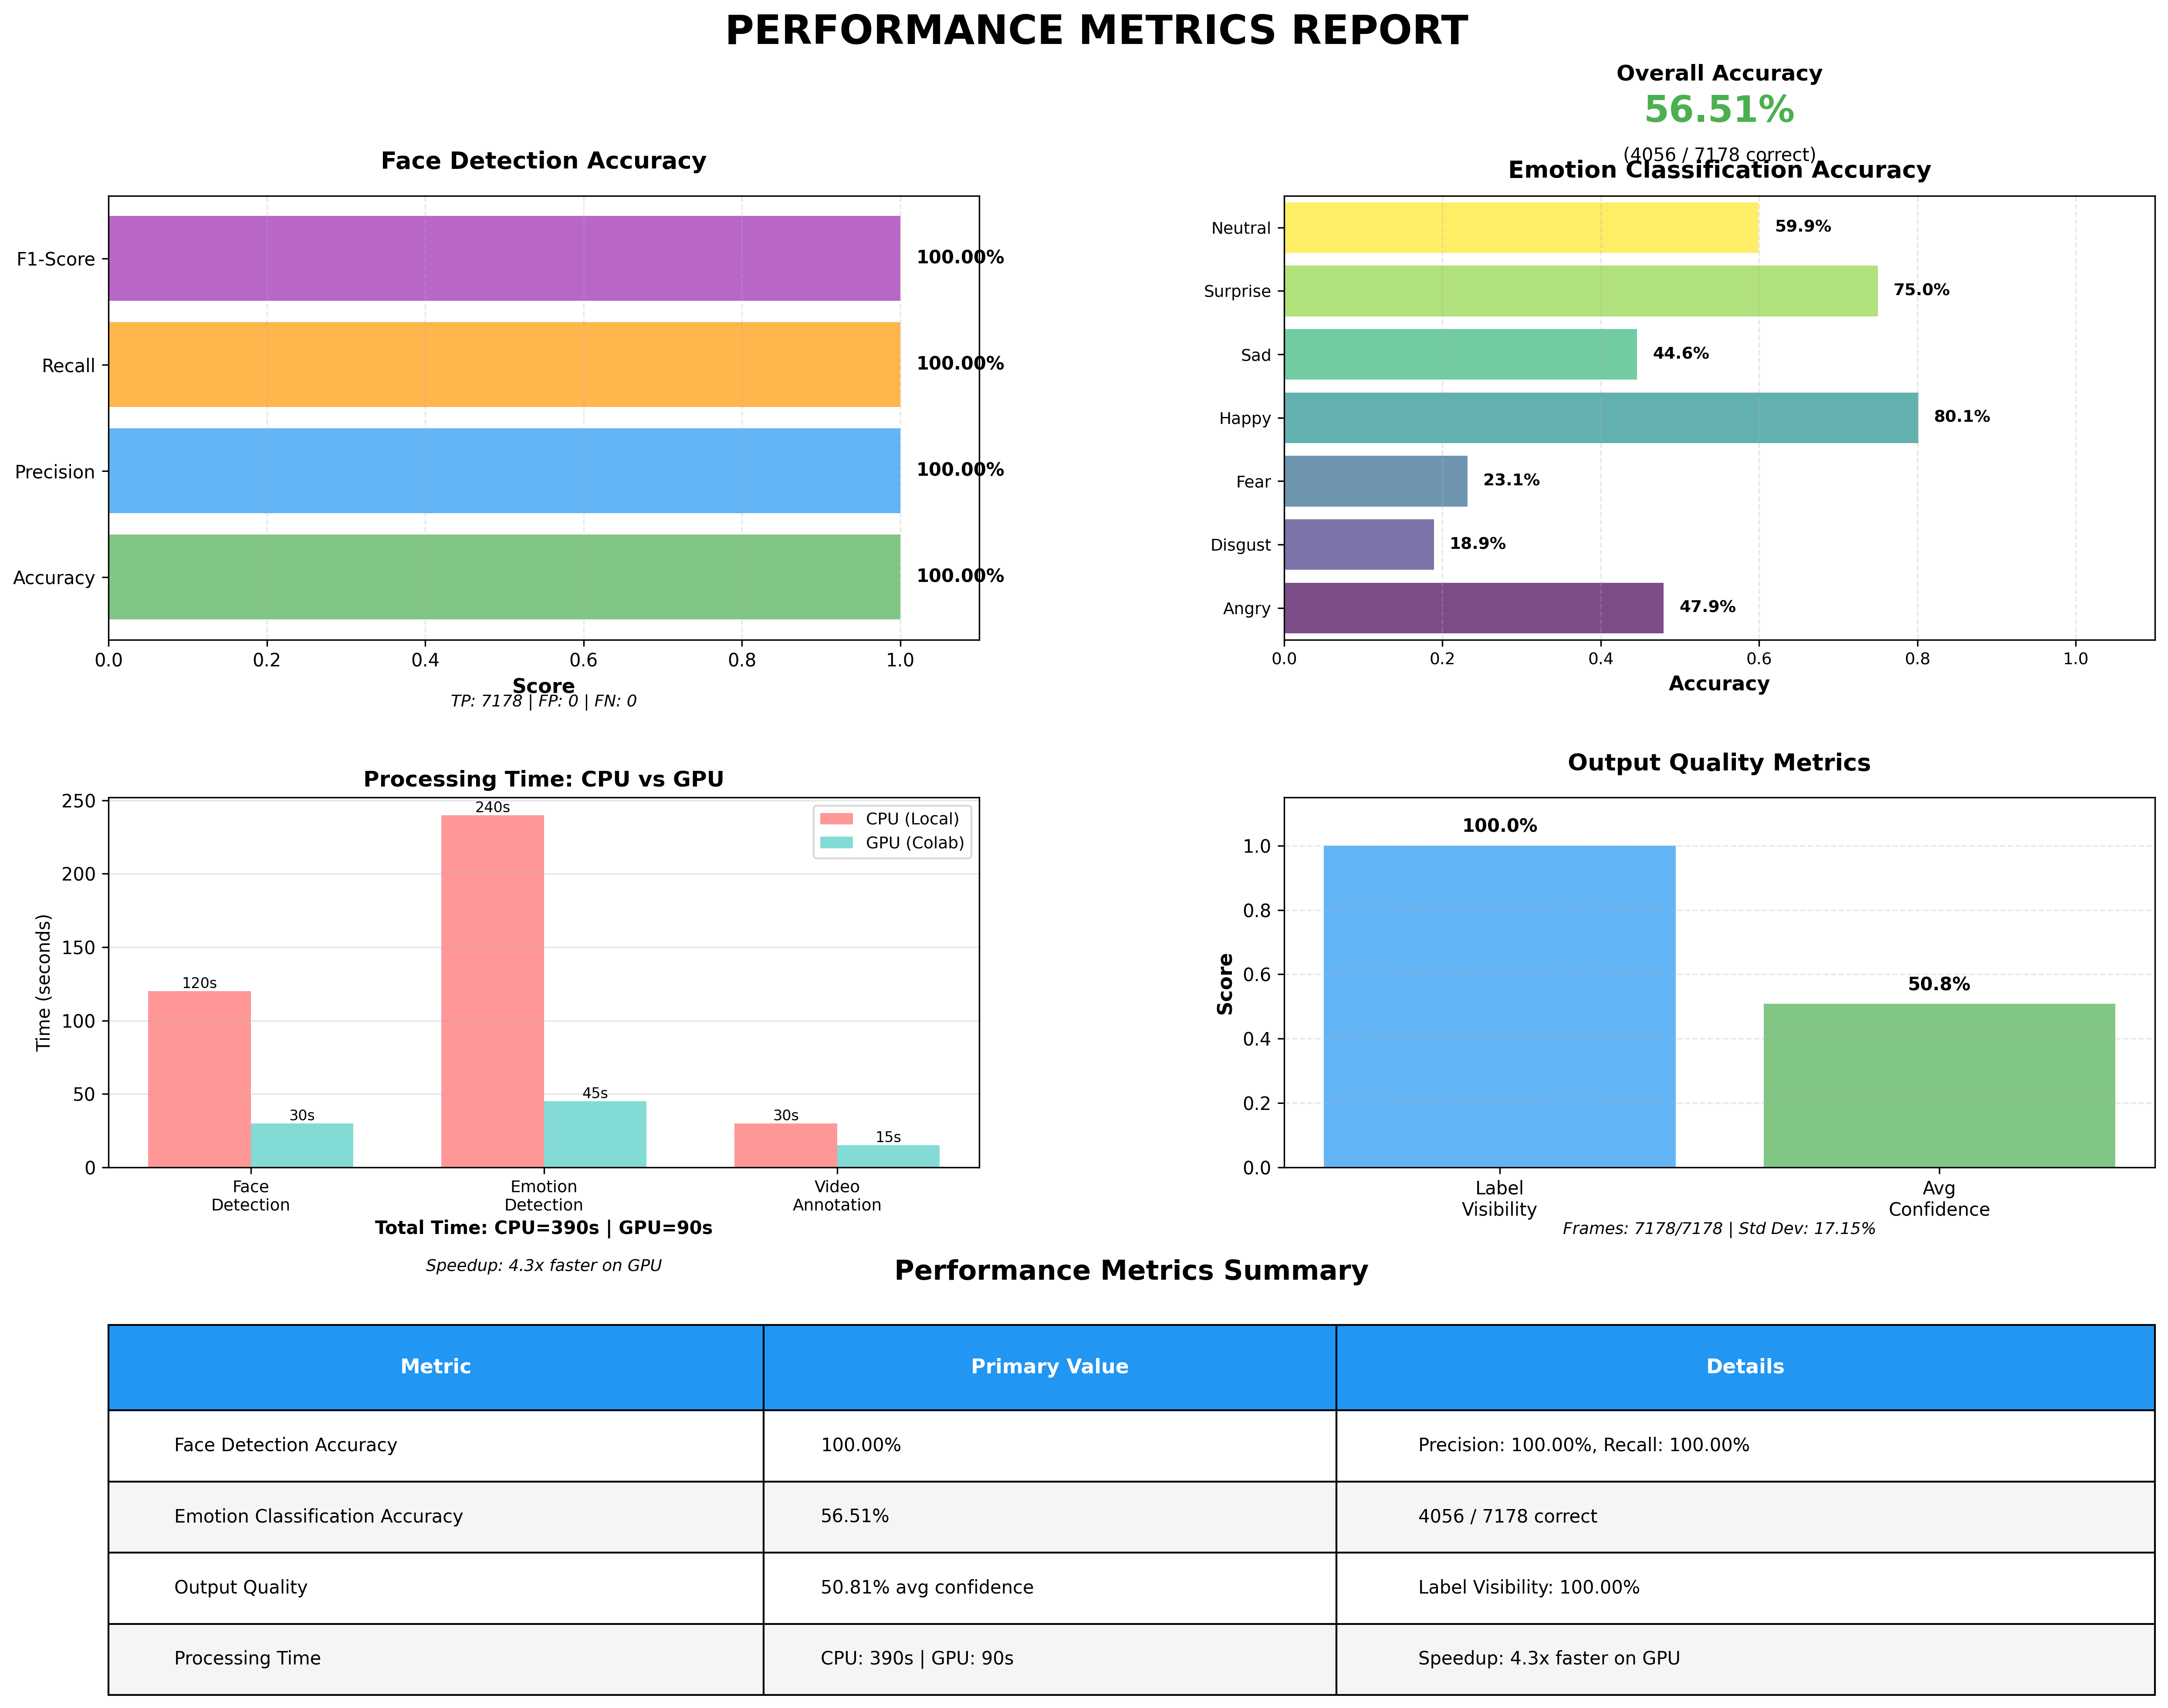
Outputs - Performance Metrics
Face detection achieves 100% accuracy, ensuring reliable tracking.
Emotion accuracy (56.51%) is measured using single-image (frame-level) evaluation.
Image-based emotion detection is challenging due to pose and lighting variations.
Videos are processed frame by frame, preserving temporal continuity.
Hence, video-based analysis yields more stable and higher accuracy than images
UŽ KIEKVIENOS TECHNOLOGIJOS – ŽMOGUS
14

Slide 15
References
https://encord.com/blog/google-mediapipe/
https://mediapipe.readthedocs.io/en/latest/solutions/face_detection.html
https://medium.com/sciforce/face-detection-explained-state-of-the-art-methods-and-best-tools-f730fca16294
https://learnopencv.com/face-detection-opencv-dlib-and-deep-learning-c-python/
https://debuggercafe.com/face-detection-with-dlib-using-cnn/
https://peerj.com/articles/cs-2024/
https://www.academia.edu/figures/17019577/table-4-strengths-and-limitations-of-fer-techniques
UŽ KIEKVIENOS TECHNOLOGIJOS – ŽMOGUS
15

Slide 16
References (Cont…)
https://go.smarteye.se/emotion-ai-101-all-about-emotion-detection-and-affectivas-emotion-metrics
https://www.itqlick.com/affectiva
https://learnopencv.com/face-recognition-models
https://news.ycombinator.com/item?id=42584896
https://techskillguru.com/opencv/advantages-and-disadvantages-of-opencv
https://www.theknowledgeacademy.com/blog/face-detection-with-opencv
https://learn.microsoft.com/en-us/azure/ai-foundry/responsible-ai/face/characteristics-and-limitations
https://learn.microsoft.com/en-us/azure/ai-services/computer-vision/identity-quotas-limits
UŽ KIEKVIENOS TECHNOLOGIJOS – ŽMOGUS
16

